Slide 1

TEL UPDATE
BoS/Open Meeting. 12 July 2022
School of Life Sciences TEL Team
Robert Treharne
Jack Foster
Joanne Ball
Shaun Hazell
tel-life@liverpool.ac.uk

Slide 2
RESITS
2022/23 Canvas Course Shells
2022/23 Assignments
Late penalties

Slide 3
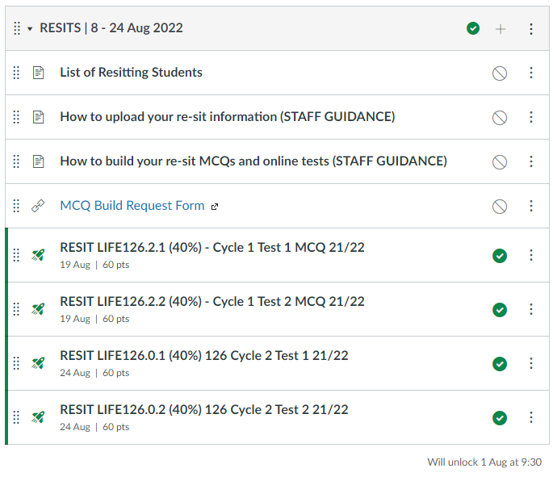
RESITS
Year 1. Example. LIFE126
RESIT MCQs DO NOT contain your questions
Please follow guidance on how to build your MCQs
All tests have been created with default time limit of 60 min. Please adjust accordingly.
Need help? Complete the MCQ Build Request Form

Slide 4
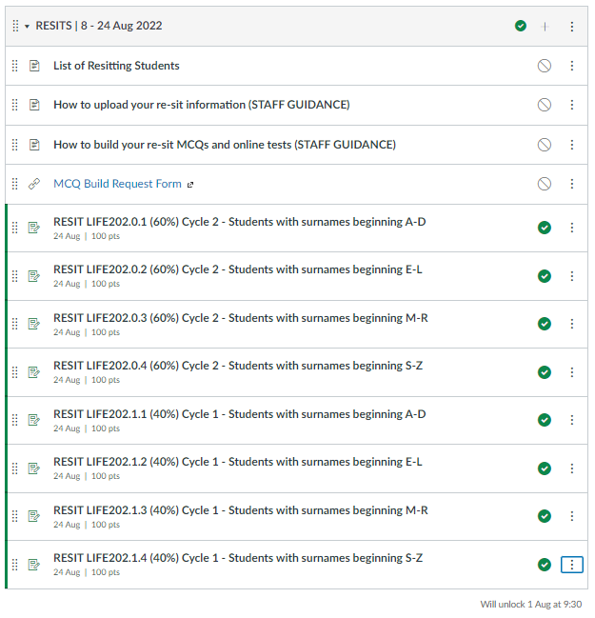
RESITS
Year 2. Example. LIFE202
Please upload exam information before 1 Aug (follow guidance).
Consolidate assignment links if necessary.
DO NOT edit assignment component codes (e.g. LIFE202.0.1)

Slide 5
RESITS
Year 3/Masters.
Waiting until 15 July
Will set up ad hoc resit links.

Slide 6
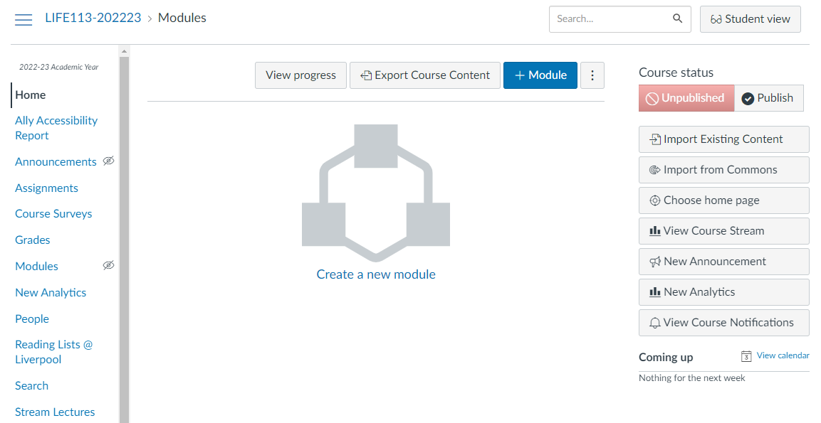
2022/23 Canvas Course Shells

Slide 7
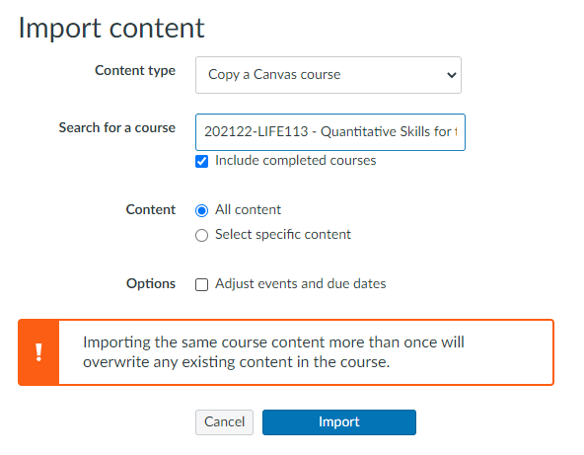
2022/23 Canvas Course Shells
PLEASE DO NOT IMPORT “ALL CONTENT” FROM A PREVIOUS COURSE
https://www.liverpool.ac.uk/intranet/strategic-change-blog/canvas-at-liverpool/good-practice-content-copying/

Slide 8
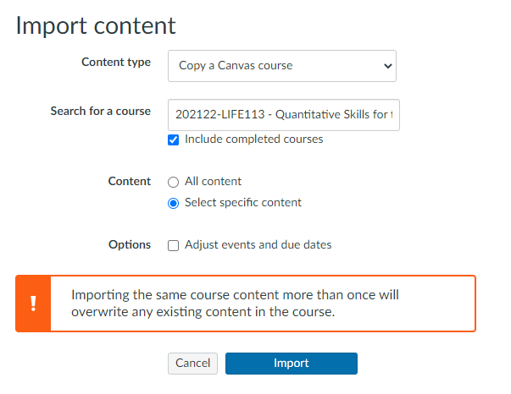
2022/23 Canvas Course Shells
SELECT SPECIFIC CONTENT!

Slide 9
2022/23 Assignments
TEL will create cycle assignment links before Sept.
TEL will create MCQ placeholders. Please build your tests. Guidance provided.
Need help with MCQs? Submit the build request form.
Assignment weightings will be reflected in Grade Centre this year!

Slide 10
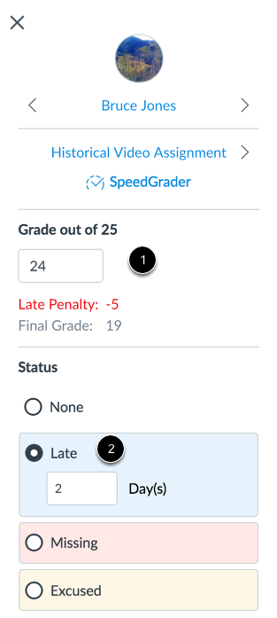
Late Penalties 2022/23
Late penalties will be applied automatically next year.
Module organisers, DO NOT APPLY LATE PENALTIES.
https://theuniversityofliverpool.sharepoint.com/:w:/s/LIFE-TEL-202223-Assessment/EcRyQ-9kAMhDhyxMUZexDS0BC0f4QhAhaCZYk6pVJQyXiA

Slide 11
For all TEL related enquiries:
tel-life@liverpool.ac.uk

